Slide 1
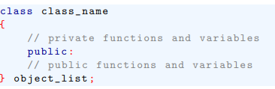
Introducing Class
A class is declared using the class keyword.
The syntax of a class declaration is similar to that of a structure. Its general form:

Slide 2
Introducing Class
In a class declaration, the object-list is optional.
We can declare class objects later or as needed.
The class-name becomes a new type name that is used to declare objects of the class.

Slide 3
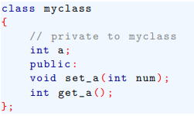
Introducing Class
Functions and variables declared inside a class declaration are said to be members of that class.
By default, all functions and variables declared inside a class are private to that class.
This means that they are accessible, only by other members of that class.

Slide 4
Introducing Class
To declare public class members, the public keyword is used, followed by a colon.
All functions and variables declared after the public specifier are accessible both by other members of the class and by any other part of the program that contains the class.

Slide 5
Introducing Class
Although functions set_a() and get_a() are declared by myclass, they are not yet defined.

Slide 6
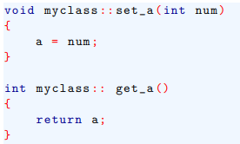
Introducing Class
To define a member function, we must link the type name of the class with the name of the function.
We do this by preceding the function name with the class name followed by two colons.
The two colons are called scope resolution operator.

Slide 7

Introducing Class
In general, to define a member function you must use this form:
Here class-name is the name of the class to which function belongs

Slide 8
Introducing Class
To create an object, use the class name as a type specifier. For example, this line declares two objects of type myclass.
A class declaration is a logical abstraction that defines a new type.
An object declaration creates a physical entity of that type. That is, an object occupies memory space, but a type definition does not.

Slide 9
Introducing Class
To create an object, use the class name as a type specifier. For example, this line declares two objects of type myclass.
A class declaration is a logical abstraction that defines a new type.
An object declaration creates a physical entity of that type. That is, an object occupies memory space, but a type definition does not.

Slide 10

Introducing Class
Once an object of a class has been created, your program can reference its public members by using a dot operator.
Assuming the preceding object declaration, the following statements call set_a() for objects ob1, ob2:

Slide 11
Introducing Class
As comments indicate, these statements set ob1’s copy of a to 10 and ob2’s copy to 99.
Each object contains its own copy of all data declared within the class.
This means that ob1’s a is distinct and different from the a linked to ob2.
Each object of a class has its own copy of every variable declared within the class.

Slide 12
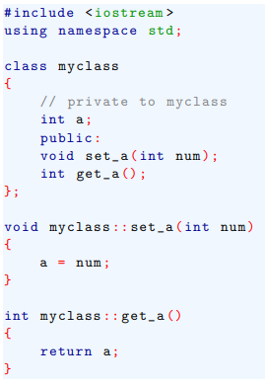
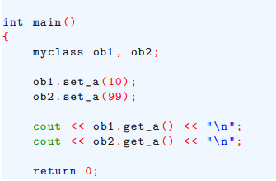
Introducing Class
A simple example, it sets the value of a of ob1 and ob2 and then displays a’s value for each object:

Slide 13
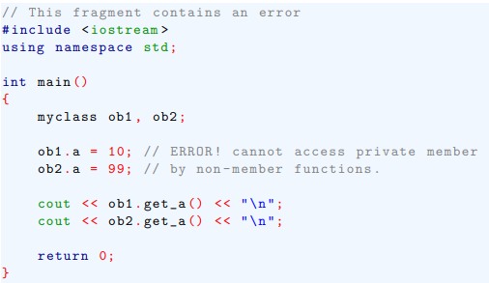
Introducing Class
If you try to access a private member of a class from some part of your program that is not member of that class, a compile-time error will result.

Slide 14
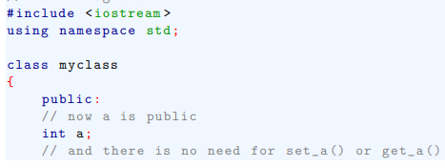
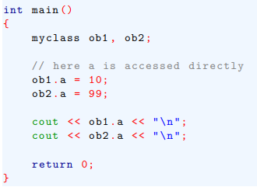
Introducing Class
Just as there can be public member functions, there can be a public member variables as well.

Slide 15
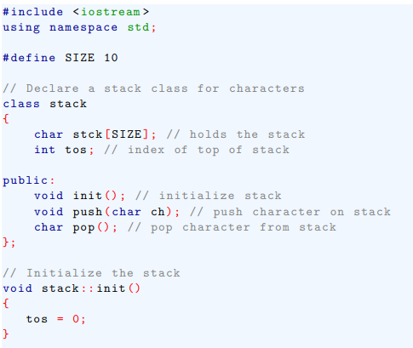

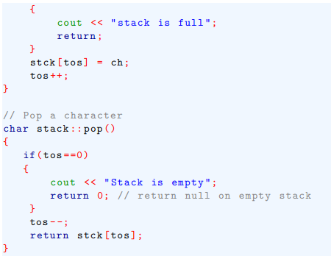
Introducing Class
A more practical example .

Slide 16
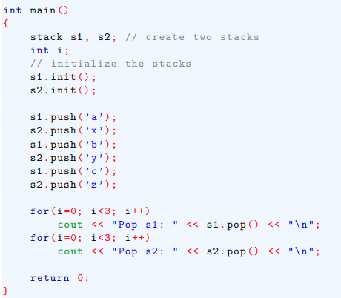
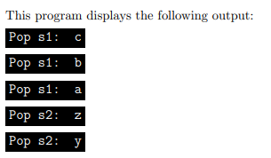
Introducing Class

Slide 17
Constructor and Destructor function
It is common part of a program that requires initialization, specially long program.
In fact, when applied to real problems, virtually every object you create will require some sort initialization.
To address this situation, C++ allows a constructor function to be included in a class declaration.
A class constructor is called each time an object of that class is created.

Slide 18
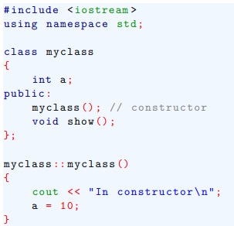
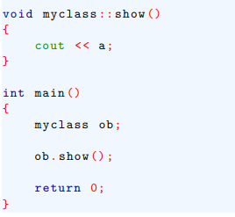
Constructor and Destructor function
Thus, any initialization that needs to be performed on an object can be done automatically by constructor function.
A constructor function has same name as the class of which it is a part and has no return type.

